Slide 1
Effective Inter-Clause Modeling for End-to-End Emotion-Cause Pair Extraction
ADVISOR:JIA-LING KOH
SOURCE:ACL 2020
SPEAKER:LI-WEI LIU
DATA:2020/12/22

Slide 2
OUTLINE
Introduction
Method
Experiment
Conclusion

Slide 3
INTRODUCTION ECPE task
Notes:
Dataset 保證至少有一句

Slide 4
INTRODUCTION
Compare with ECPE 2-Step method :
End-to-End model (Improve the main shortcoming of 2-step method).
Add the concept of relative position when calculating the relationship.
Join the ranking perspective to solve the candidate's extraction.
Notes:
這篇也是以ECPE 2-Step這篇為baseline model去比較
2-step主要缺點:第一步的錯誤會影響之後的表現(換句話說就是loss沒有一起訓練)
在計算相互關係時加入了相對位置的概念
加入排名視角以解決候選人的提取

Slide 5
OUTLINE
Introduction
Method
Experiment
Conclusion

Slide 6
METHOD Problem definition
Input a document contains multiple clauses : d = [c₁, c₂, … , c_{|d|}]
Each c_{i} also contains multiple words : c_{i} = [w_{i,1},w_{i,2}, … ,w_{i,|ci|}]
Output is emotion-cause pairs in d : P = { ... , c^{emo} -c^{cau}, ... }

Slide 7
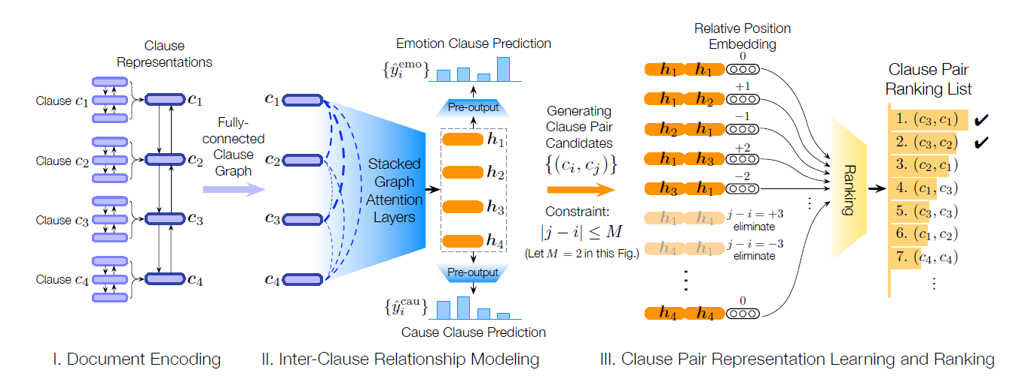
FRAMEWORK

Slide 8
METHOD Document Encoding
Word-level Bi-LSTM modules :
c_{i} ‘s each word =
get hidden state
And each c_{i}’s representation h^{i}:
Bi-RNN
(C₁,C₂…C_{|D|})

Slide 9
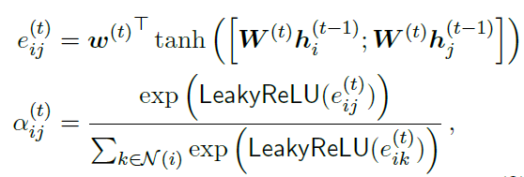
METHOD Inter-Clause Relationship Modeling
Each clause aggregating neighboring clauses’ information using self-attention
Graph attention network:
First layer’s input
And last layer’s output
Notes:
t是graph attention layer的layer數

Slide 10
METHOD Pre-predict emotion and cause
Predict the probability of each clause
being an emotion clause/cause clause:
logistic function
Notes:
t是graph attention layer的layer數

Slide 11
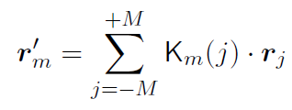
METHOD Relative position embedding
Clause pair candidates:
In paper, M=12
Learn final pair representation:
r : relative position embedding
= 1
Notes:
2個句子差距<=M才會被選為候選
Km(j) 跟第m句距離越遠的j句，值會越小，所以是類似在計算相似度
RPE:https://zhuanlan.zhihu.com/p/105001610

Slide 12
METHOD Pair prediction (Ranking)
Use final representation to predict
emotion-cause pair’s score for ranking:
logistic function
Top-N rank: (N=3)
Top-1: As an answer pair
Other pair p^{i}=(c^{i,1},c^{i,2}):
Use sentiment lexicon to determine whether the clause c^{i,1} contains sentiment word(s)
Notes:
作者認為rank後的結果設門檻值來篩選會無法適用在所有文本

Slide 13
METHOD Loss function
loss:
: cross-entropy (mean)
Notes:
cross-entropy (mean) : 整個文本來看，emo/cau 的loss為每個句子的cross-enntropy結果的平均

Slide 14
OUTLINE
Introduction
Method
Experiment
Conclusion

Slide 15
EXPERIMENT DataSets
We constructed a ECPE corpus based on the benchmark ECE corpus(from SINA NEWS website)

Slide 16
EXPERIMENT Evaluation on the ECPE Task
Notes:
先讓他們看paper的table2 看不用BERT的效果，再帶到這裡
稍微講一下pretrained BERT ecoder怎麼做的

Slide 17
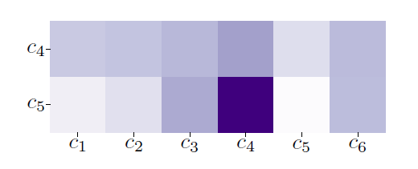
EXPERIMENT Case Analysis
Correct Ans is (c5,c4):
(c1)
(c2)
(c3)
(c4)
(c5)
(c6)
Notes:
Emo: c5 Cau: c4

Slide 18
OUTLINE
Introduction
Method
Experiment
Conclusion

Slide 19
CONCLUSION
We propose RANKCP to tackle the problem of emotion-cause pair extraction:
which emphasizes inter-clause modeling from a ranking perspective.
and integrates relative position enhanced clause pair ranking.
Notes:
我們提出了RANKCP，從排名的角度強調了子句間的關係，
並整合了相對位置增強子句對排名，
來解決情感原因配對提取的問題。

